Slide 1

GURU GHASIDAS UNIVERSITY, CHHATISGARH session: 2021-2022 PROJECT REPORT ON “online note sharing”
SUBMITTED BY:
Srijan bhuwal
GGV/20/05061
ROLL NO: 20606057
M.C.A 3 semester
UNDER SUPERVISINON OF:
Miss. Shushma Jaiswal
(CSIT DEPARTMENT)

Slide 2
contents
Introduction
Need of the system
Language description
Flow chart
Hardware and Software Requirement
Screenshot
Merits and demerits
Future aspects
Summary
Reference

Slide 3
Introduction
College notes gallery project is developed using PHP, JavaScript, and CSS. Talking about the project, it contains just a user side. All the management are done from the user side like uploading the reading materials. From the user side, the users can view the homepage and see the contents available there. Through this site, the college can maintain the student’s notes with more ease. He / She can upload them and also can edit them. It is difficult for teacher’s to circulate their notes to each and every student whom is he/she teaching. College Notes Gallery provide an easy approach for both students and teachers to circulate the notes whether of any kind like lecture notes, assignment questions, question papers and all the important documents. The teachers and students can upload the documents from any where and students can download it.
Overall it is managed by the admin

Slide 4
Need of the system
Previously the management work was done manually.
It was a tedious job and also time consuming Therefore it was need to develop a computerized system which will reduce the complexity, improve efficiency and should be economically feasible

Slide 5
Definitions of Languages used:
HTML is the standard markup language for creating Web pages
PHP is a server-side language that can be used in conjunction with a database to create dynamic web pages. By the word "dynamic" it allows you to input or query data from a web page.
SQL is a standard language for storing, manipulating and retrieving data in databases.
JavaScript, often abbreviated as JS, is an interpreted programming language that conforms to the ECMAScript specification. JavaScript is high-level, often just-in-time compiled, and multi-paradigm
CSS describes how HTML elements should be displayed.

Slide 6
Requirements:
Hardware Requirement
Processor – Intel i3 7th generation
RAM – 4 GB
System Type – 64-bit windows operating system
Model – Lenovo Ideapad 310kb
Memory Required – 500 mb
Software Requirements:
Technologies used - Language used - html,css,sql,php,javascript

Slide 7

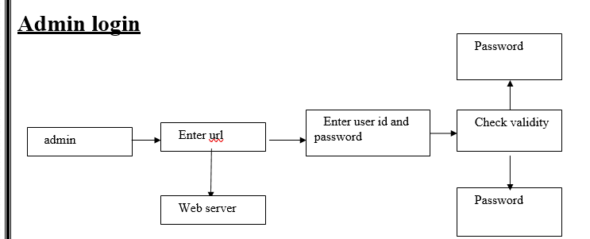
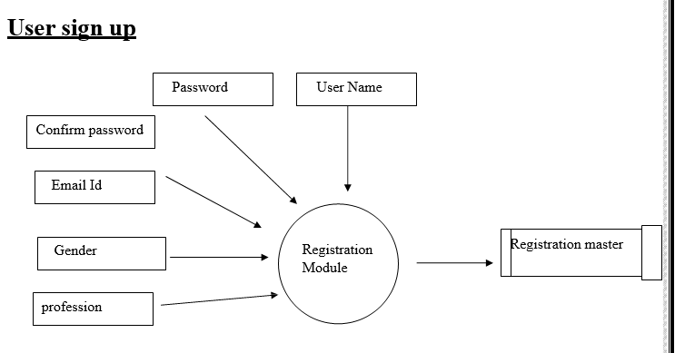
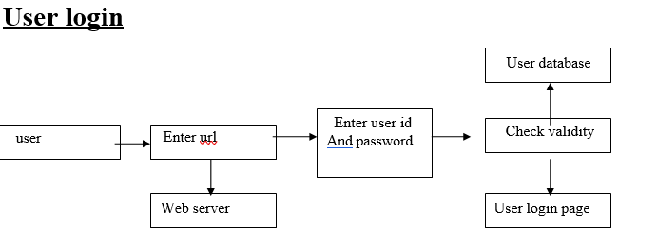
Flowchart:

Slide 8

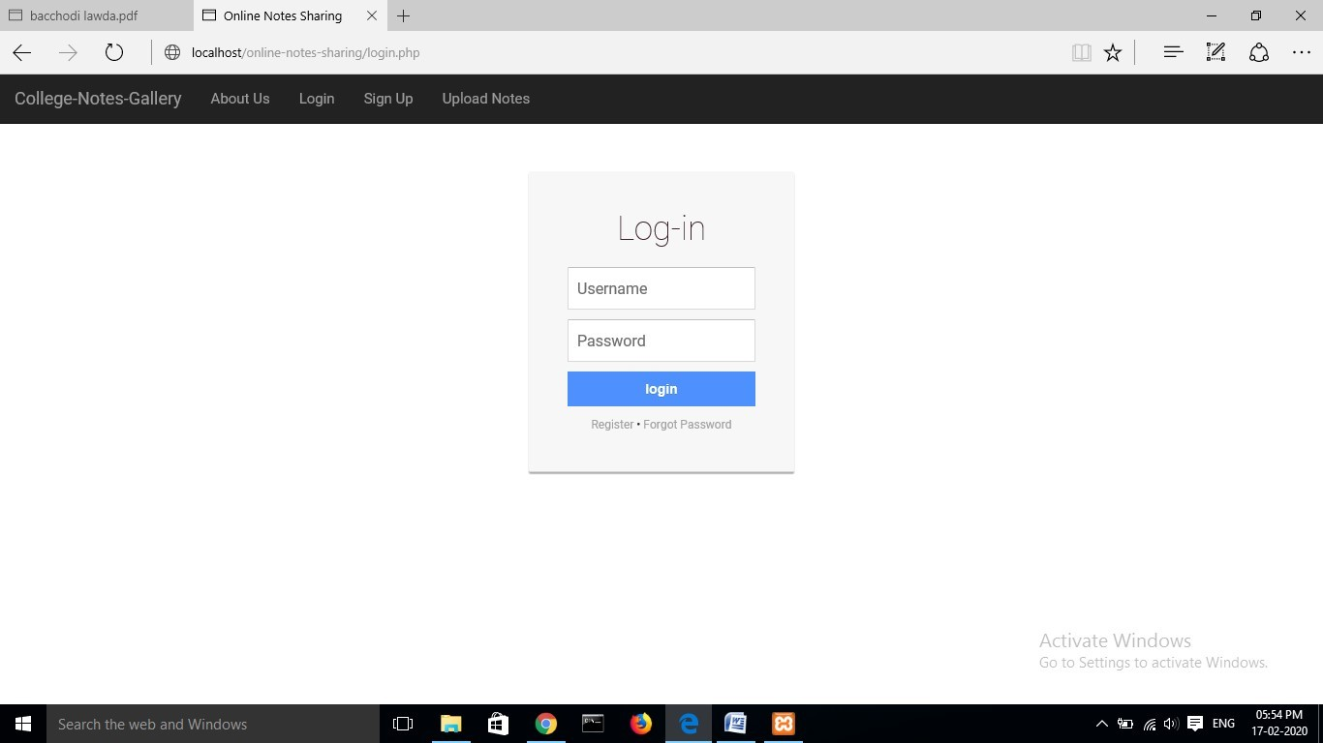
Screenshot:

Slide 9
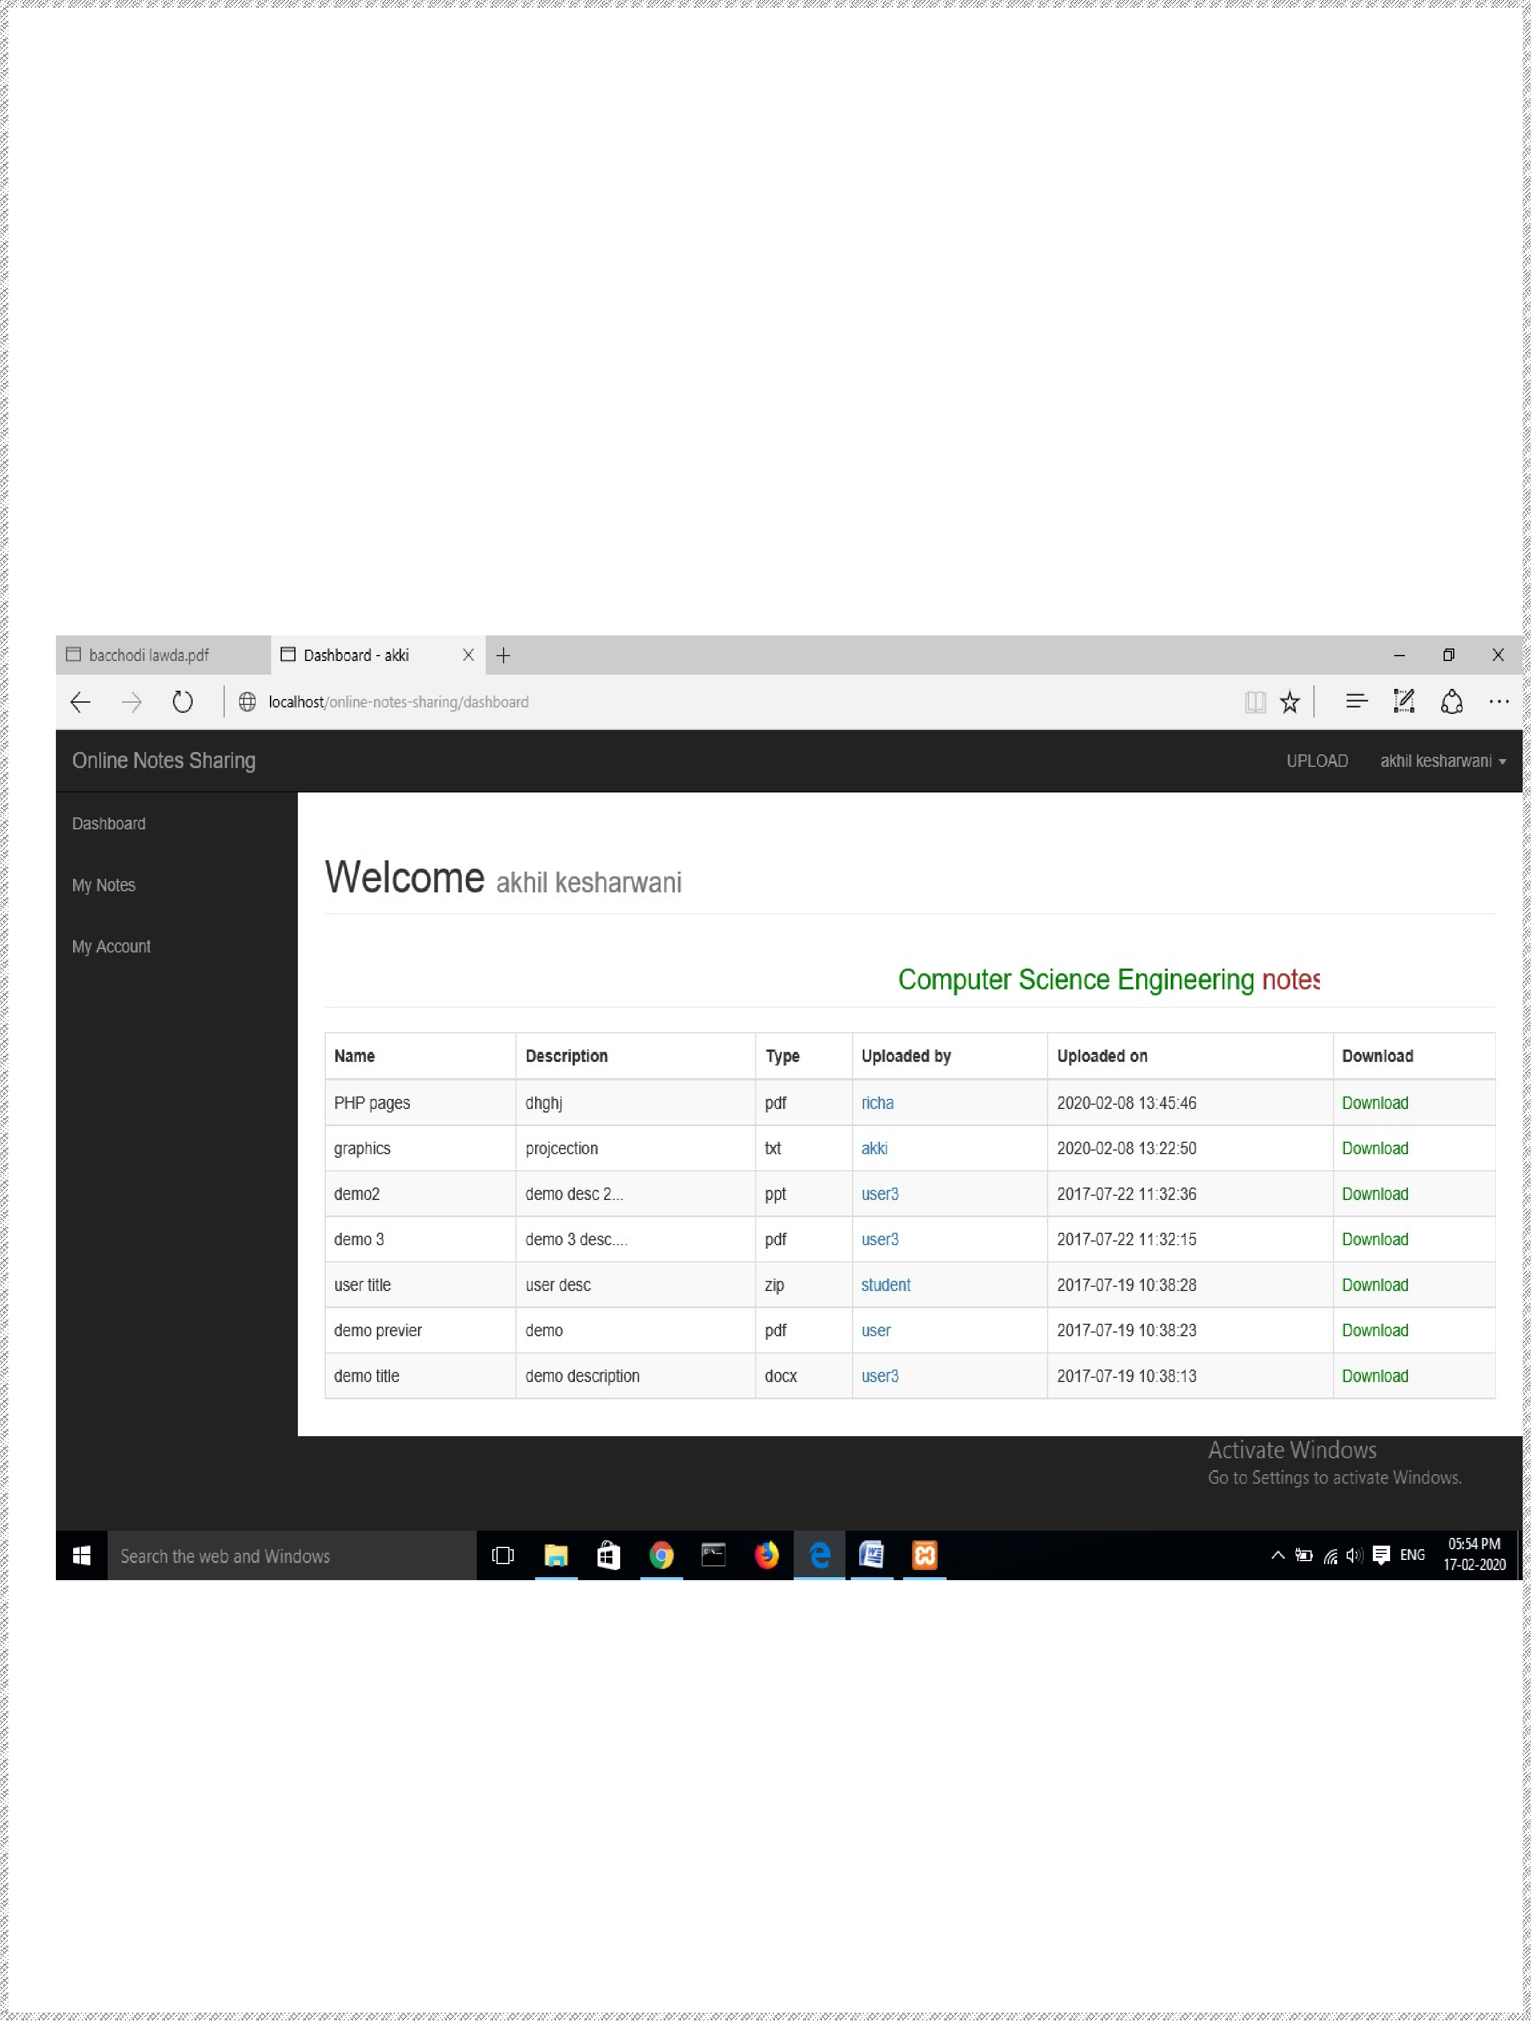

Slide 10
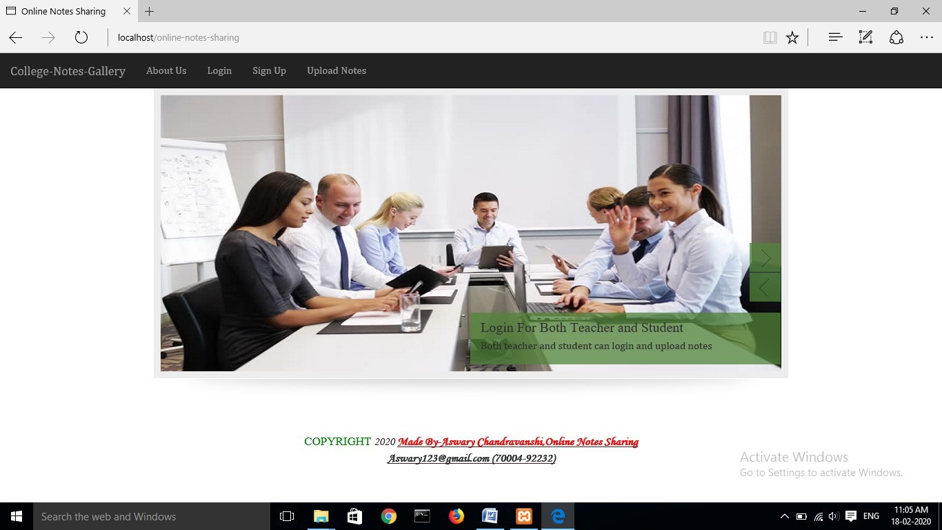

Slide 11
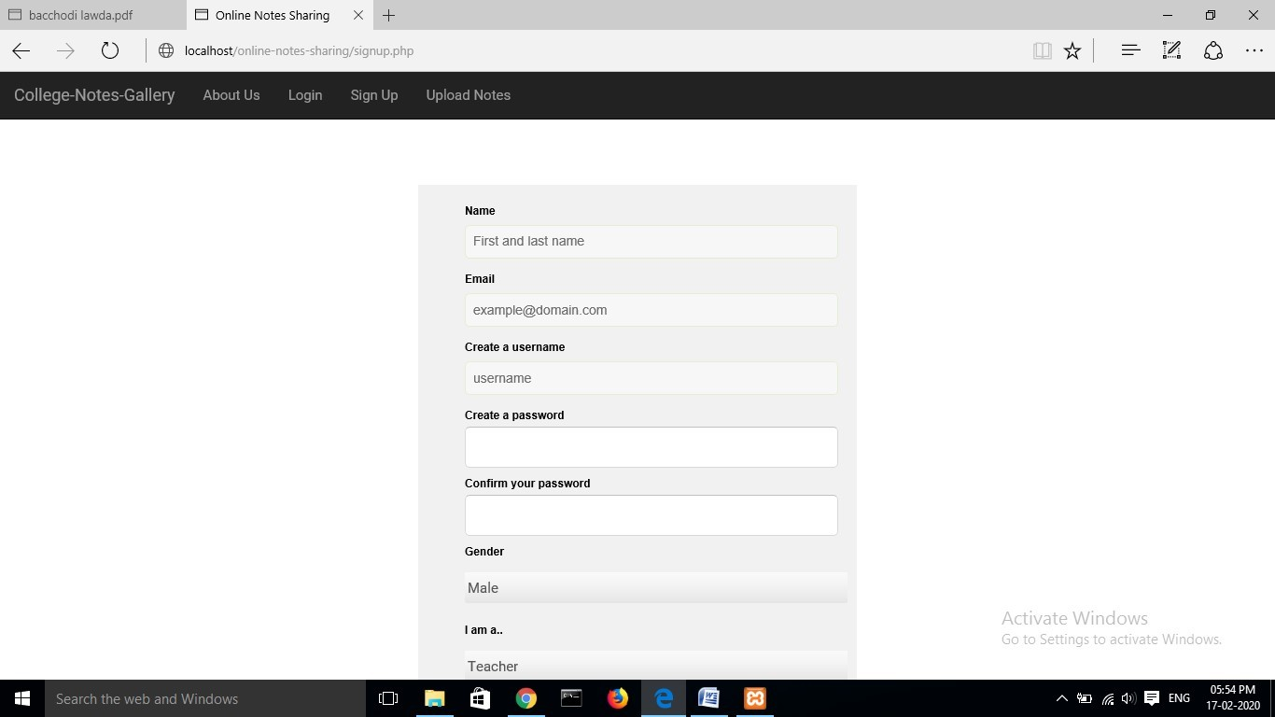

Slide 13
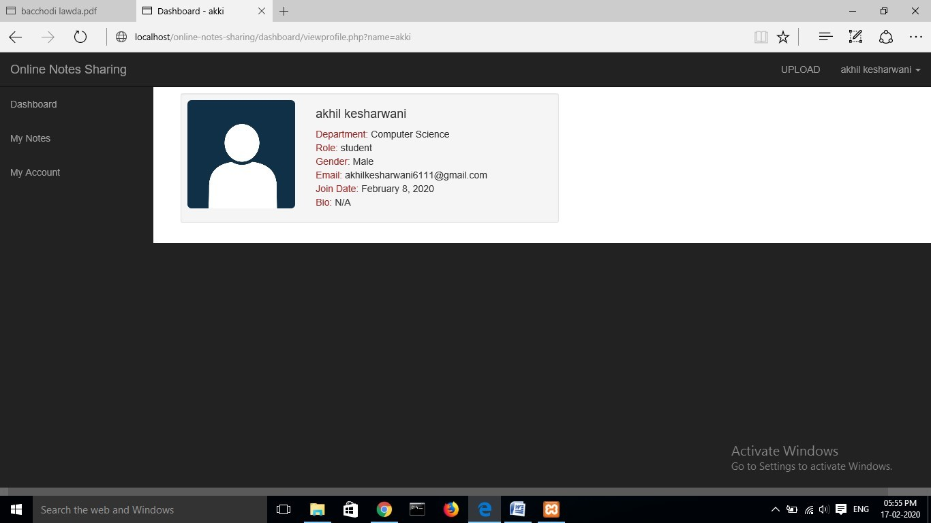

Slide 14
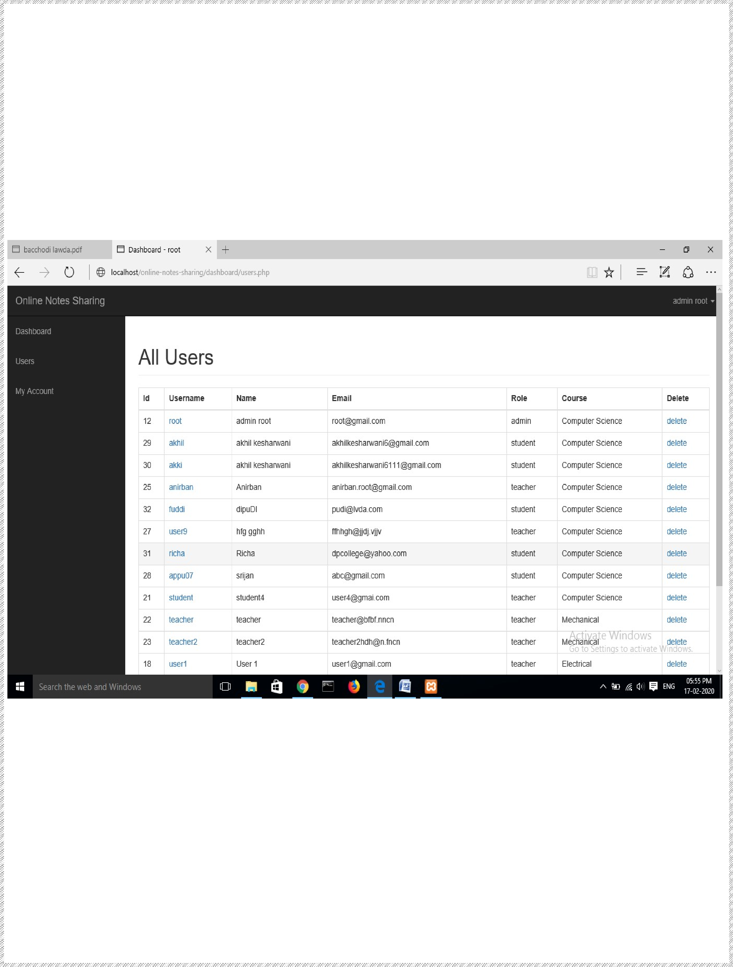

Slide 15
Merits
Multiple user access: Allows multiple type of users(teacher/student/admin) to login
Functional Admin panel: Allows admins to manage the whole system
CRUD functionalities: Allows all users to create ,read , update and delete their notes in a managed format
Profile update option: Allows users to update their profile/account details
Secure registration and login option for users
Allows students and teachers to download/upload their course notes easily
Allows users to recover their password using forgot password option

Slide 16
Demerits
Details are enquired through phone.
It consumes more time
They don’t get proper notes.

Slide 17
Future Aspects
It will get evolute through out the time
More beneficial as per future aspects

Slide 18
Summary
The project titled “ONLINE NOTE SHARING” is designed using Active Server Pages
This project intends to provide the students with an environment where they can upload their notes online. By doing this, it will allow them to gain the basic knowledge about using any kind of project management system. This project has only a single agenda, that is, to allow students to upload their study materials online like google classroom.

Slide 19
Reference
BOOK:
.PHP MySQL Website Programming: Problem - Design – Solution byChris Lea, Mike Buzzard, Dilip Thomas, Jessey White-Cinis
Beginning PHP5, Apache, and MySQL Web Development (Programmer toProgrammer) by Elizabeth Naramore
MySQL/PHP Database Applications, 2nd Edition by Brad Bulger
How to Do Everything with PHP and MySQL by Vikram Vaswani
WEBSITES :
www.slideshare.net
www.stackoverflow.com

Slide 20
conclusion
It is concluded that the application works well and satisfy the both registered and registered. The application is tested very well and errors are properly debugged. The site is simultaneously accessed from more than one system.
The site works according to the restrictions provided in their respective browsers. The speed of the transactions become more enough now. In this site the user can search the appropriate answers for their questions.. They can view their favorable questions, articles and inventions.

Slide 21
Thankyou

